Slide 1

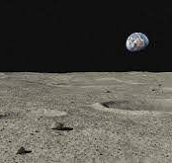
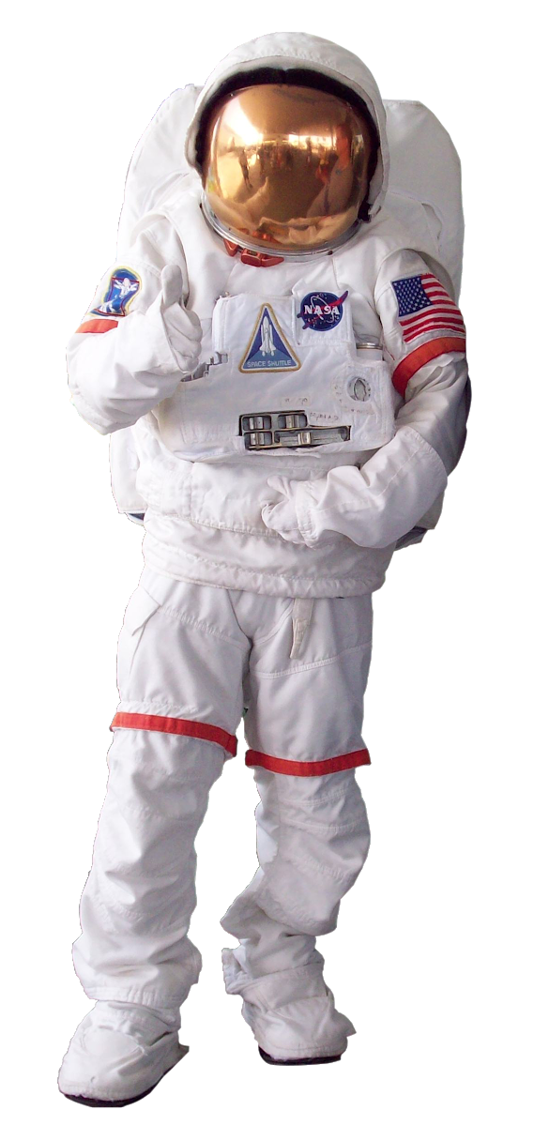
CONCEPT OF OPERATIONS
1
Astronaut should ensure the surface is relatively flat and cleared
2
Astronaut lays out E.A.S.E in front of the lunar habitat and connects it to power source
4
Astronaut leaves. E.A.S.E waits for another astronaut for two minutes, after which it self-cleans for several minutes, removing the dust from its surface by pushing it off its right edge, before entering standby mode until the pressure sensor is activated again.
3
After moonwalk and sample collection, astronaut returns to stand on E.A.S.E, which senses the weight and begins attracting dust off the astronauts’ boots and moving it to the center and the left and right edges

Slide 2
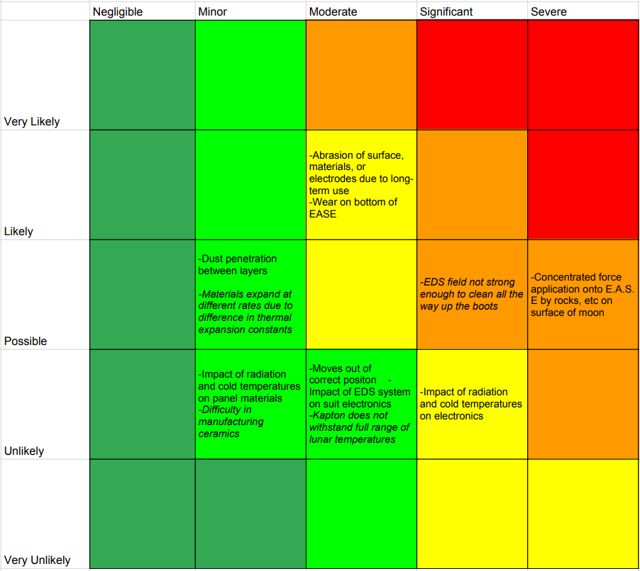
RISK ASSESSMENT CHART
RISK MITIGATION STRATEGIES:
Impact of radiation and cold temp on electronics:
The likelihood of single particle upsets is very low
MLI (multi-layered insulation) should protect the electronics from cold temperatures
EDS field not strong enough to clean all the way up the boots
EDS geometry and electronics are easily altered to increase the field strength
Abrasion of surface, materials or electrodes due to long-term use
Ceramic has high abrasion resistance

Slide 3
RISK ASSESSMENT CHART
RISK MITIGATION STRATEGIES CONT’D:
Dust penetration between layers
Kapton is being compressed between two ceramic panels and acts as a gasket
Concentrated force application onto E.A.S.E. by rocks on the surface of the moon
Not a problem if astronauts clear the area
Wear on bottom of E.A.S.E., as well as moving out of position:
The spikes on the bottom of E.A.S.E secure it to the surface, limiting slipping and abrasion by loose particles underneath it

